Slide 1
Authority tool implementation

Slide 2
Outline
1. Objective
2. Model outline
3. Algorithm
4. Implementation

Slide 3
Objective
1. Author name disambiguation
2. Estimating whether a pair of articles sharing same author name were written by the same individual.

Slide 4
Authority model
Input: Pair of articles sharing common author name
Output: Probability of whether the common author name refers to the same individual.

Slide 5
Model outline
A similarity profile (comparison vector), x is computed between two articles.
If x is more frequently observed (r-value) in positive (match) training sets, then the pair of articles were written by the same individual and vice versa.
Positive (match) sets implies sample of training data which share some common properties like author name and coauthors and are likely to be written by the same person.

Slide 6
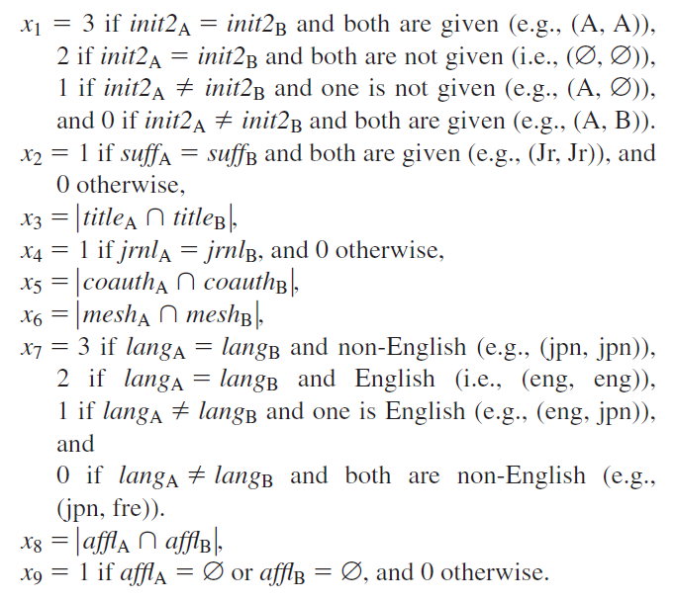
The similarity profile or comparison vector, x
Given pair of articles, the comparison vector (or similarity profile)
x = <x1, x2, x3, x4, x5, x6, x7, x8, x9>
Rules:

Slide 7
Similarity profile in our case
Some of the metadata is unavailable. Hence similarity profile in our case has attributes: x = <x1, x2, x3, x4, x5, x7>
Example:
x1 = 3, x2 = 0, x3 = 0, x4 = 1, x5 = 0, x7 = 2

Slide 8
The relative frequency, r-value
Mathematically, let P(x|M) and P(x|N) denote probability of observing similarity profile x given that pair of articles were written by the same person and different person respectively.
r(x) = P(x|M) / P(x|N).
Higher r(x) implies that the pair of articles were more likely written by a same individual and vice versa.

Slide 9
Example
Positive sets similarity profiles Negative sets similarity profiles
Pair | Similarity profile <x>
(a1, b1) | <3, 0, 0, 1, 0, 2>
(a2, b2) | <2, 1, 1, 0, 0, 2>
(a3, b3) | <2, 1, 1, 0, 0, 2>
(a4, b4) | <2, 1, 1, 0, 0, 2>
Pair | Similarity profile <x>
(a5, b5) | <3, 1, 0, 1, 0, 1>
(a6, b6) | <1, 1, 1, 0, 0, 2>
(a7, b7) | <2, 1, 1, 0, 0, 2>
(a8, b8) | <3, 1, 1, 0, 0, 2>
Given a pair of articles (a9, b9) with similarity profile x = <2, 1, 1, 0, 0, 2>, they are most likely written by the same individual.

Slide 10
Is the r-value enough?
The probability also depends on other factors like how unusual the given name is. The probability that a pair of articles written by a unique author name is a same individual is higher than articles written by a common author name.
Hence the probability P(M|x) depends on P(x|M) / P(x|N) (i.e., the r(x)) and the prior match probability P(M).

Slide 11
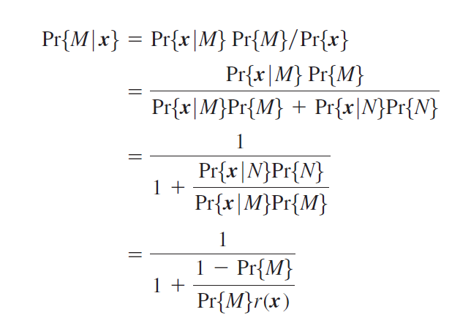
Mathematically…

Slide 12
Training sets (positive and negative sets)
The following sets are generated based on certain conditions:
Article attribute match set [pairs matching on first_name, last_name, middle_name and suffix]
Article attribute non match set [pairs differed on last_name]
Named attribute match set [pairs matching on first author’s first_initial and last_name and share one or more coauthors]
Named attribute non match set [pairs matching on first author's first_initial and last_name but do not share coauthors]

Slide 13
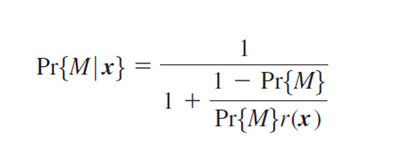
Lookup r-table
For all possible values of x, r(x) is pre-computed.
P(M|x) is easily calculated by looking up for the r-value given x from the table. If r(x) does not appear in the table, it is either interpolated or extrapolated depending on certain conditions.

Slide 14
Basic procedure
Extract features.
Generate training datasets.
Compute the lookup r-table.
Calculate the probabilities.
Clustering.

Slide 15
Computing the look up r-table
Given xml files that contain the metadata of the articles. So, parse the xml files of articles to extract metadata information and store them to a database.
Generate the reference sets i.e., match and non-match sets.

Slide 16
Compute x (similarity profile) on all pairs of all sets.
<x1> and <x2> are computed independently on name sets. <x3, x4, x5, x7> let say <xa> are computed on article sets.
The relative frequency r(x) = r(x1, x2, x3, x4, x5, x7). Since <x1>, <x2> and <xa> are computed independently, r(x) = r(x1)*r(x2)*r(xa)
r(xa) is smoothened to improve accuracies and to ensure monotonicity. r(x) <= r(y) for all (x,y) where xi<=yi i=1,2,3,4,5,7.
Example:

Slide 17
Implementation
Design
Code flow

Slide 18
Design
JSTOR database
MySQL DB
Training Sets
Similarity profiles x in json files
Lookup table in json file
Smoothing table in matlab

Slide 19
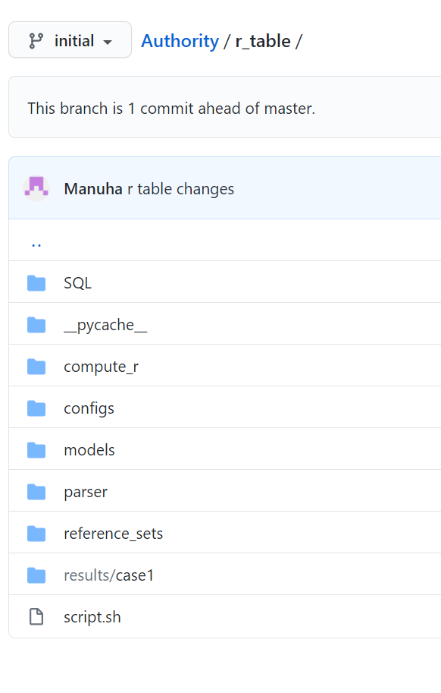
Code structure

Slide 20
Code walkthrough
https://github.com/SternerLab/Authority/tree/initial/r_table

